Slide 1

TWITTER SENTIMENT ANALYSIS
ALY 6040 – FINAL PROJECT
BY – ARCHIT BARUA
BHAGYASHRI KADAM
NIKSHITA RANGANATHAN
PROFESSOR - BEHZAD AHMADI
Notes:
slidesppt.net
‹#›

Slide 2


PROJECT TIMELINE
@ALY6040
Week 1
Data Cleaning, Feature Engineering & EDA
Week 2
Text Preprocessing, Decision Tree and Random Forest
Week 3
KNN Model
Week 4
Support Vector Machine
Week 5
Text mining and Wordcloud
Week 6
Multinomial Logistic Regression
Notes:
slidesppt.net
‹#›

Slide 3






SENTIMENT ANALYSIS
Link -
TWEET

Slide 4



About the Dataset
@kaggle
Rows - 14640
Columns -15 (Categorical -11, Numerical- 4)
Missing Observations - 4118
Target variable - Airline sentiment (Positive, Negative and Neutral)
Details of tweets between 16th to 24th Feb 2015 for 6 US Airlines
Important Statistics
Avg Length of Tweets - 7191 Characters
Mean Retweet Count - 0.08
Notes:
slidesppt.net

Slide 5
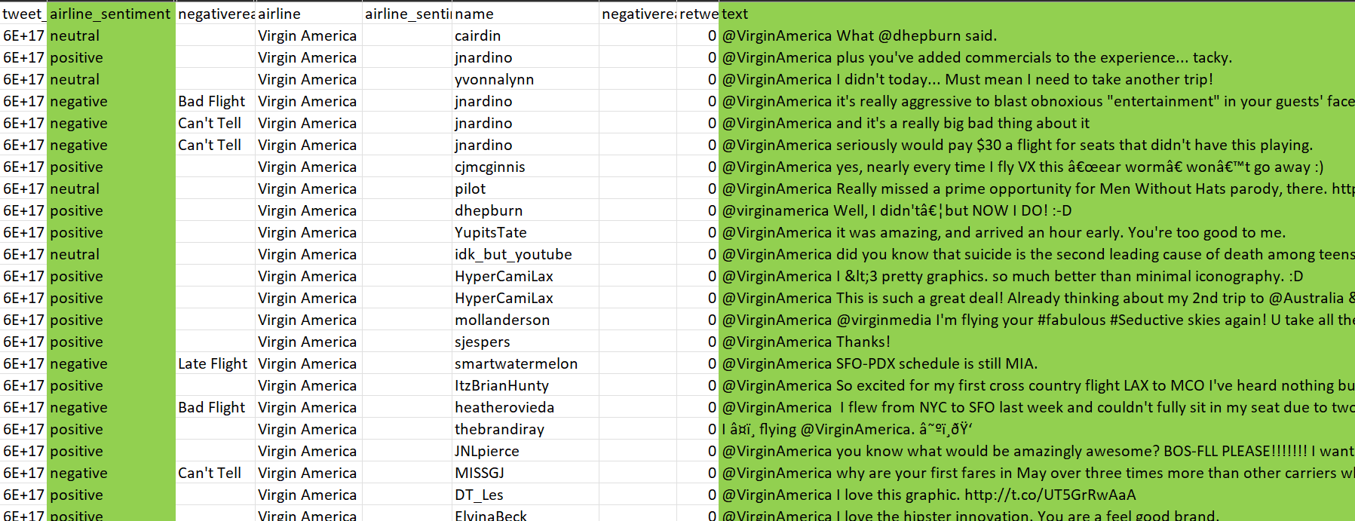
About the Dataset
@kaggle
Notes:
slidesppt.net

Slide 6






Infographic Style
BUSINESS QUESTIONS
Sentiment Distribution by Airline?
Peak Tweet times and patterns?
Locations with highest tweet count?
Top reasons for negative sentiment?
Ways to improve customer service?
Frequently used words in tweets?
TWEET
Notes:
slidesppt.net
‹#›

Slide 7
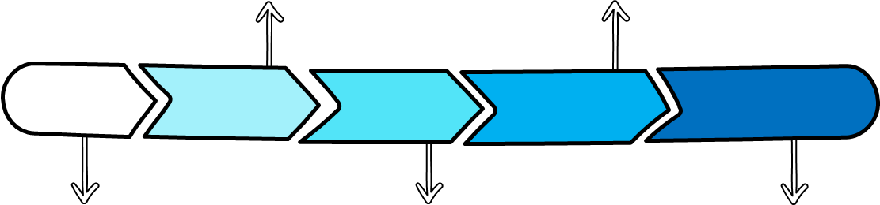
DATA CLEANING
@Twitter
Removing duplicate records
Recoding columns
Handling Missing values
Dropping Irrelavent columns
Modifying the datatypes
2:35 AM
Notes:
slidesppt.net

Slide 8
EXPLORATORY DATA ANALYSIS
@Twitter
American Airlines experiences largest spike on 23rd Feb 2015
Virgin America has consistently low tweet numbers throughout the period with minimal fluctuations..
TWEET
Notes:
slidesppt.net

Slide 9
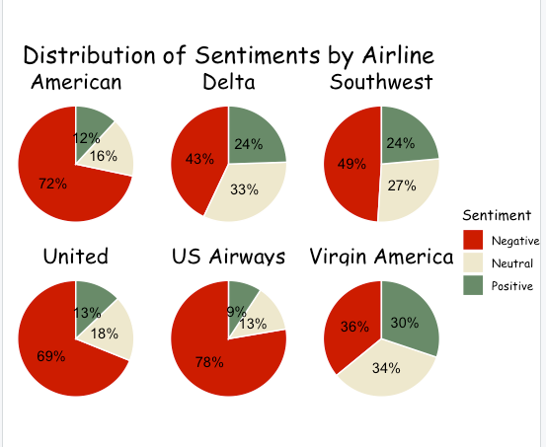
EXPLORATORY DATA ANALYSIS
@Twitter
All the airlines have the majority of tweets expressing negative sentiments.
US Airways and American Airlines having the highest proportion of negative tweets at over 70%
Virgin America has relatively balanced distribution of Tweets.
TWEET
Notes:
slidesppt.net

Slide 10
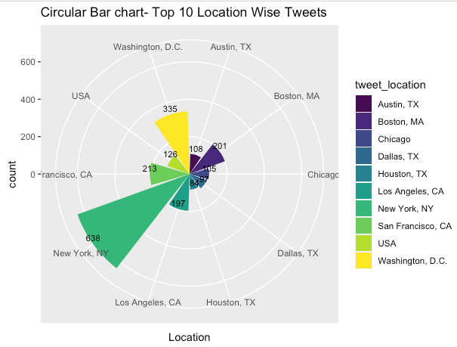
EXPLORATORY DATA ANALYSIS
@Twitter
Highest number of tweets are from New York (638), followed by Washington, D.C (335) & San Francisco (213).
Least number of tweets have been received from Houston, TX (84) & Dallas, TX (97).
TWEET
Notes:
slidesppt.net

Slide 11
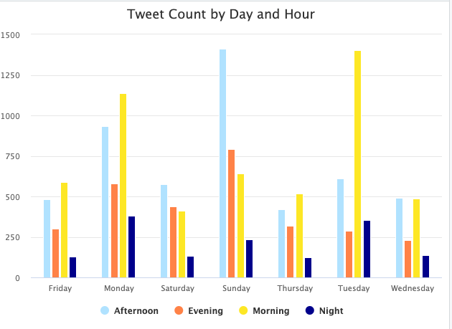
EXPLORATORY DATA ANALYSIS
@Twitter
The highest number of tweets for any day of the week is 3079 tweets on Sunday followed by Monday, with 3032 tweets. The lowest number of tweets is on Wednesday, with only 1344 tweets.
Additionally, the highest number of tweets for any day and hour of the day is 1465 tweets on Tuesday morning followed by Sunday afternoon with 1410 tweets.
The lowest number of tweets is on Wednesday night, with only 138 tweets.
TWEET
Notes:
slidesppt.net

Slide 12
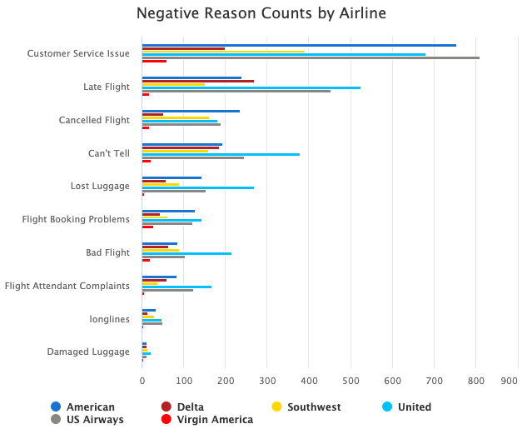
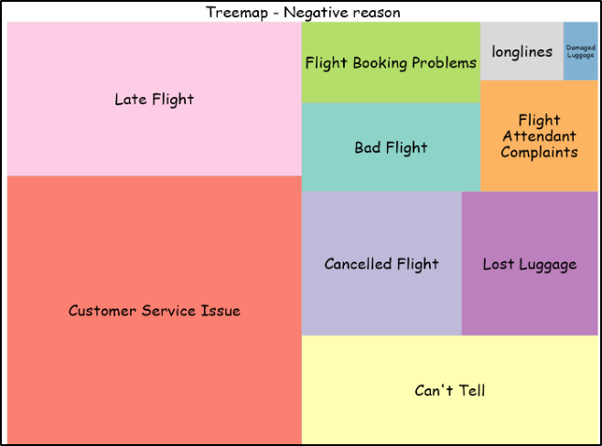
EXPLORATORY DATA ANALYSIS
@Twitter
Most common negative reason for tweets about US airlines is "Customer Service Issues," followed by "Late Flight" and "Can't Tell”.
Other negative reasons include "Cancelled Flight", "Lost Luggage", "Bad Flight", "Flight Booking Problems", "Flight Attendant Complaints", and "longlines".
TWEET
Notes:
slidesppt.net

Slide 13
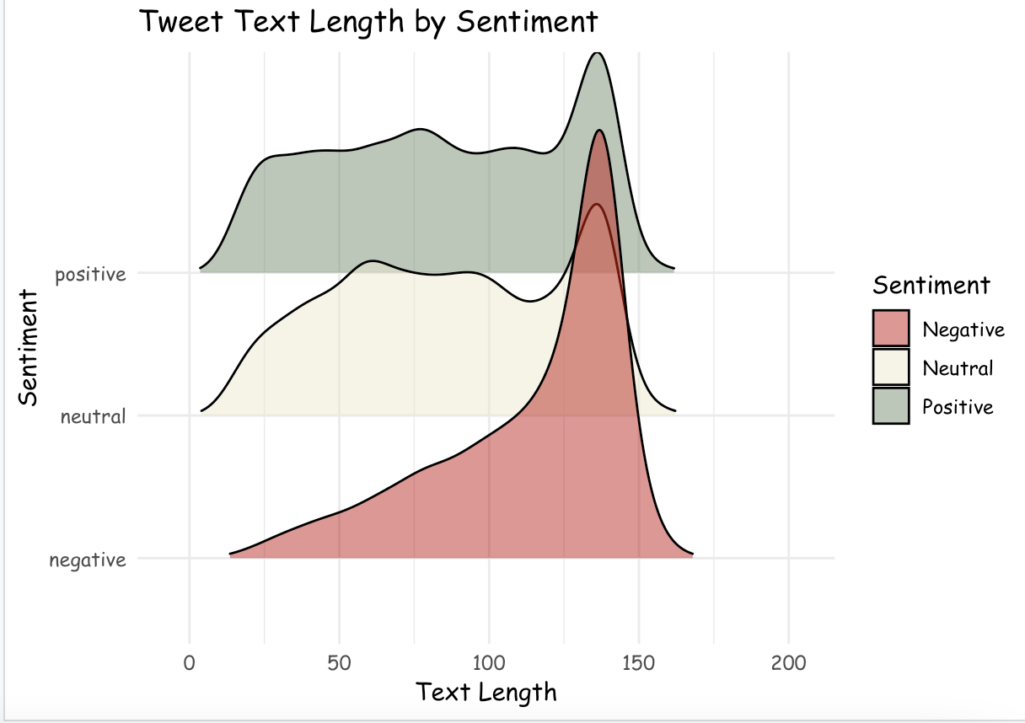
EXPLORATORY DATA ANALYSIS
@Twitter
Negative sentiment tweets are typically longer than neutral and positive tweets, and people tend to express negative experiences with more details and explanations.
TWEET
Notes:
slidesppt.net

Slide 14

Home
SENTIMENT ANALYSIS APPROACH ( NLP TECHNIQUES)
BAG OF WORDS MODEL
TF-IDF MODEL
Generalization of the Bag of Words model which uses the Term Frequency and Inverse Document frequency approach.
TF-IDF usually performs better in machine learning models.
TF-IDF model contains information on the more important words and the less important ones as well.
Simplest form of text representation in numbers.
Represents a sentence as a bag of words vector
Bag of words are easy to interpret
Notes:
slidesppt.net
‹#›

Slide 15
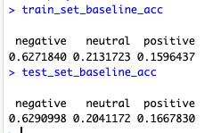
TEXT PRE-PROCESSING
@Twitter
Corpus Object
TM package to remove Punctuation , numbers , stopwords ,
whitespace , stemming etc
1
2
TermDocumentMatrix & DocumentTermMatrix.
Visualised words with frequency greater than 500
3
Splitting the dataset with 80 : 20 ( Train & Test set)
Baseline Accuracy for Train & Test set.
4
5
Notes:
slidesppt.net

Slide 16
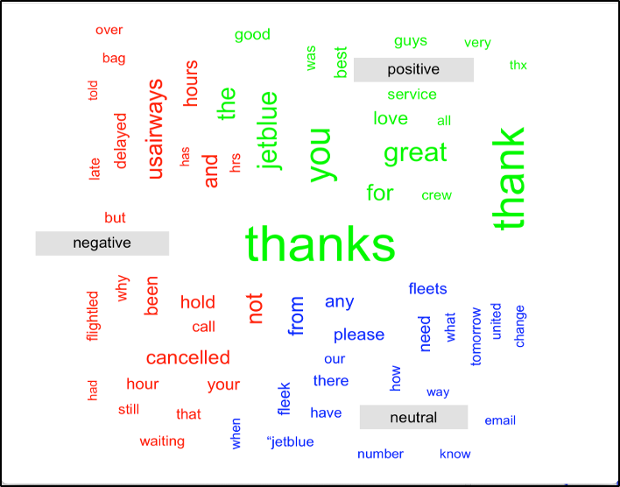
WORD CLOUD
@Twitter
Text preprocessing steps were applied to the tweets.
A term-document matrix was created to represent the tweets.
Word size in the matrix indicated frequency (larger words = higher occurrence).
Notes:
slidesppt.net

Slide 17
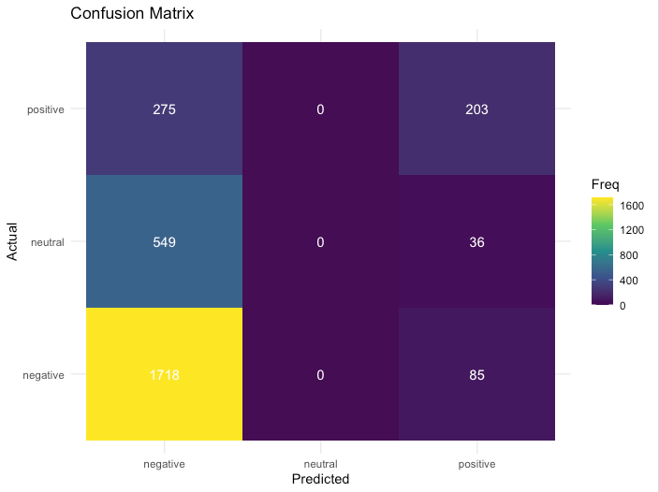
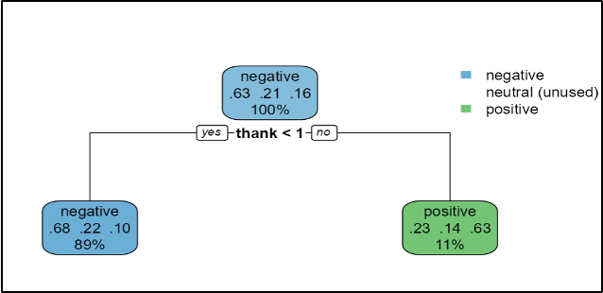
DECISION TREE MODEL
@Twitter
The CP value of 0.1171357 resulted in two splits, with a final tree containing two terminal nodes.
The "thank" variable was the most important variable in predicting sentiment.
The model was unable to provide any classification for the neutral class.
ACCURACY 67%
F1 - SCORE
0.79
Notes:
slidesppt.net

Slide 18
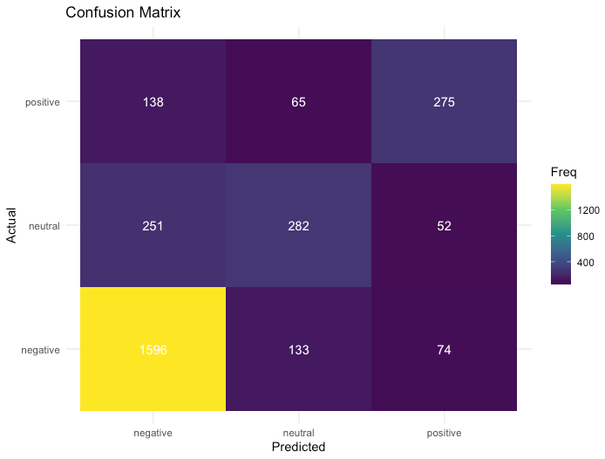
RANDOM FOREST MODEL
@Twitter
For each split in each tree, a random subset of 33 variables were considered for splitting.
The estimated out-of-bag (OOB) error rate is 26.2%
The sensitivity values for the negative, neutral, and positive classes are 0.8808, 0.45470, and 0.57950, respectively.
The specificity values for the negative, neutral, and positive classes are 0.6275, 0.90837, and 0.94556, respectively.
ACCURACY 75%
F1 - SCORE
0.84
Notes:
slidesppt.net

Slide 19
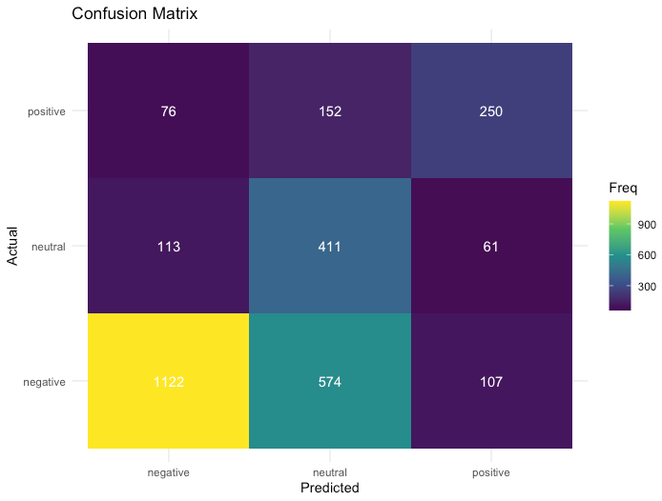
KNN MODEL
@Twitter
Data normalization: centering and scaling.
Hyperparameter tuning using grid search and 5-fold cross-validation.
Optimal 'k' value: 9
Confusion matrix & metrics showed areas for improvement, especially neutral sentiment.
ACCURACY 63.75 %
F1 - SCORE 0.72
Notes:
slidesppt.net

Slide 20
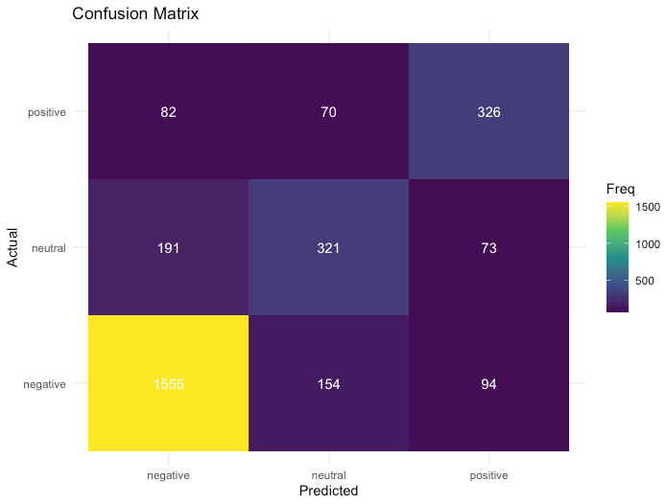
SVM MODEL
@Twitter
Used C classification and linear kernel for the model.
Negative sentiment detection: Sensitivity = 0.86, Specificity = 0.74.
Neutral sentiment detection: Sensitivity = 0.54, Specificity = 0.90.
Positive sentiment detection: Sensitivity = 0.68, Specificity = 0.90.
ACCURACY 76.80 %
F1 - SCORE 0.85
Notes:
slidesppt.net

Slide 21
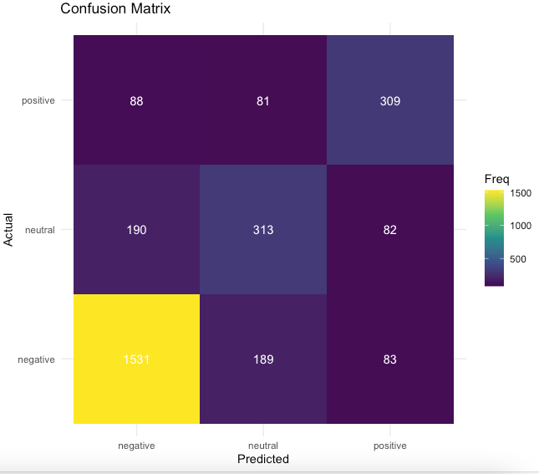
MULTINOMIAL LOGISTIC REGRESSION
@Twitter
Outcome variable: sentiment category (negative, neutral, positive)
Better performance for negative and positive sentiment compared to neutral sentiment
The sensitivity of the model was highest for negative sentiment.
ACCURACY 75.12 %
F1 - SCORE 0.84
Notes:
slidesppt.net

Slide 22
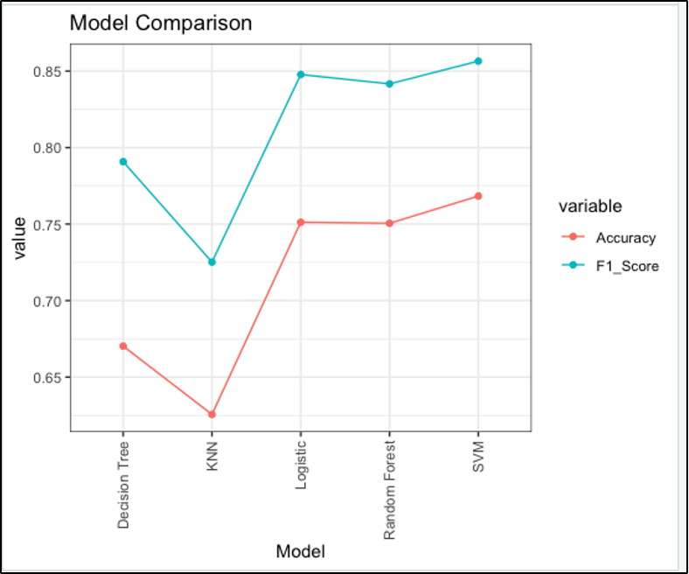
MODEL COMPARISON
@Twitter
Model | Accuracy | F1 Score | Precision
Support Vector Machine (SVM) | 76.80% | 0.86 | 84.49%
Multinomial Logistic Regression (MLR) | 75.16% | 0.85 | 83.42%
Random Forest (RF) | 75.05% | 0.84 | 83.03%
K-Nearest Neighbors (KNN) | 62.56% | 0.73 | 69.69%
Decision Tree (DT) | 67.02% | 0.79 | 76.75%
Overall, the SVM model demonstrated the highest performance in terms of both accuracy and F1 score, making it the top-performing model in this sentiment analysis task.
Among these models, SVM showed relatively better performance in classifying both negative and positive sentiments. MLR also performed well in classifying negative and positive sentiments. KNN showed better performance in classifying neutral sentiments.
Notes:
slidesppt.net

Slide 23
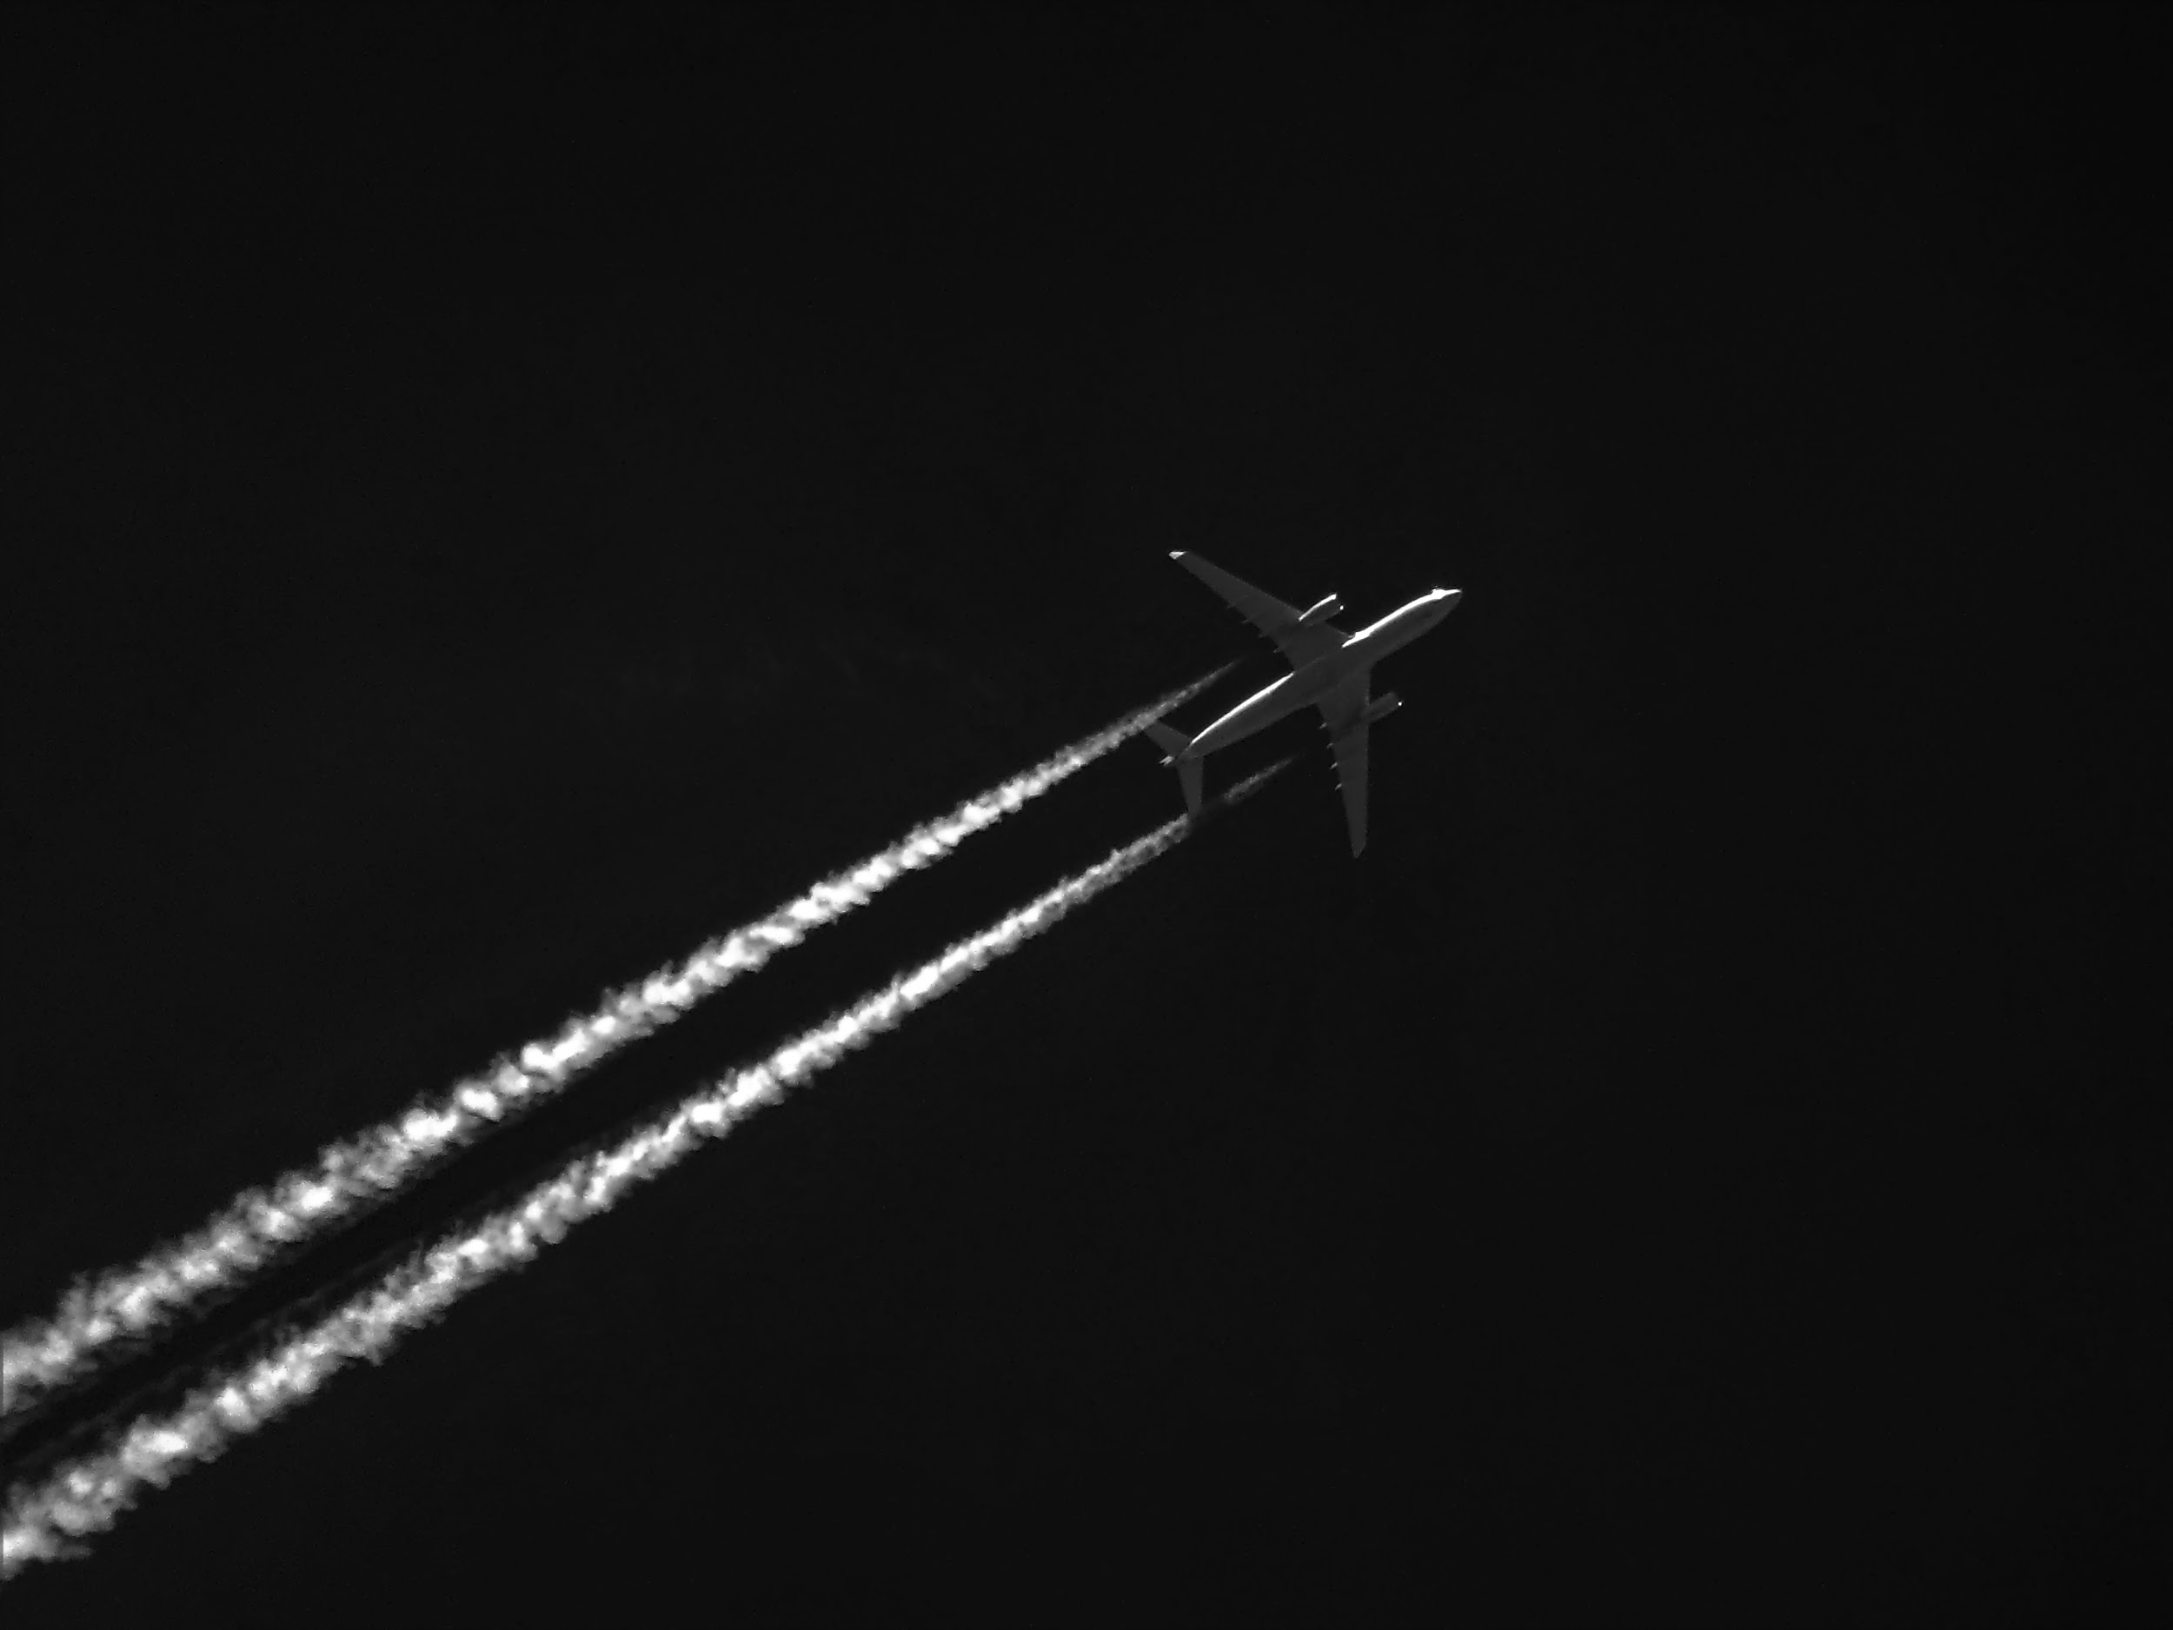
CONCLUSION
@Twitter
Sentiment analysis helps monitor brand perception and improve customer experience.
Insights help addressing customer issues, enhancing services, and making data-driven decisions.
Analyzing tweet volume over time across airlines identifies patterns and engagement opportunities.
Sentiment distribution: 62.7% negative, 21.2% neutral, 16.1% positive.
Most common negative reasons: Customer Service Issue, Late Flight.
Negative tweets longer on average.
SVM model: 76.8% accuracy, 0.8565 F1-score (Top-performing).
Random Forest (75.16%) and Multinomial Logistic Regression (75.05%) also performed well.
KNN and Decision Tree showed slightly lower performance
Notes:
slidesppt.net

Slide 24
Home
Thank you, see you on next presentation!
Everyone can reply. Any Questions ?
TWEET

